Slide 1
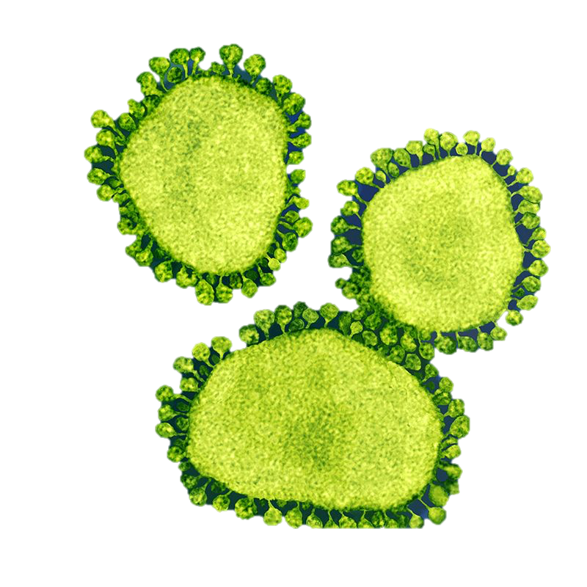
RECEPTOL® ORAL SPRAY SHIELD FOR CORONA VIRUS PROPOSED TREATMENT AND PREVENTION AS DEMONSTRATED IN AIDS
INDIAN SOLUTION TO GLOBAL Health PROBLEM
Dr. Pawan Saharan MS Ph.D.(USA) drpawan@biomix.in, www.biomix.in, +91-8291084108

Slide 2
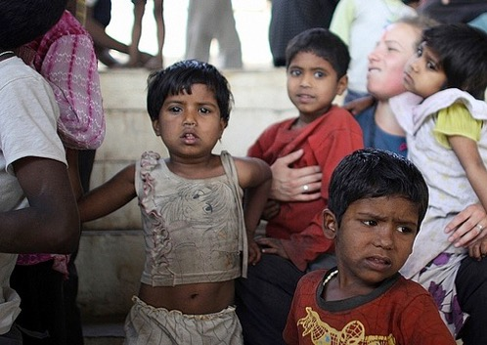
MILLIONS
SUFFER
CORONAVIRUS SWINE FLU HIV/AIDS COMMON COLD HEPATITIS A, B & C HERPES SIMPLEX I&II ACUTE & CHRONIC VIRAL INFECTIONS VIRAL RESPIRATORY INFECTIONS DENGUE FEVER HUMAN PAPILLOMA VIRUS PHARANGITIS (VIRAL) SARS RABIES ROTA VIRAL DIARRHEA ALLERGIES & ASTHMA TUBERCULOSIS ALZHEIMER BENIGN PROSTATE HYPERPLASIA HEPATIC CELLULAR CARCINOMA HYPERTENSION LUPUS (DISCOID AND SYSTEMIC) ORAL THRUSH AUTISM PREMENSTRUAL SYNDROME AND ENDOMETRIOSIS RHEUMATOID & OSTEO ARTHRITIS SPINAL MUSCULAR ATROPHY
FROM IMMUNE SYSTEM RELATED ILLNESSES

Slide 3
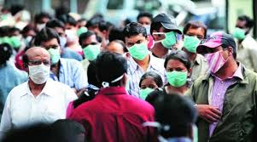
Global Health Problems – Millions suffer from
Cancer, Allergy, SARS
Coronavirus 2019-nCoV.
AIDS, TB
INDIAN SOLUTION TO GLOBAL HEALTH PROBLEMS
What if there was a way to treat all immunity disorders via
RECEPTOL®, The New Immunity drug that not only builds body’s own immune system but also prevents Recurrent infections in Cancer, Auto immune & AIDS patients
RECEPTOL® fulfills unmet needs in diseases caused due to poor immunity.
Source :IPSOS & Times studies

Slide 4
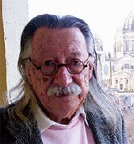
A Brief History of RECEPTOL®
RECEPTOL® is an innovative single solution to a majority of health problems, like AIDS, Swine Flue, SARS-Coronavirus related to poor Immunity as demonstrated by Global Studies on HIV Patients.
After 18 years of research, we have successfully isolated Nano peptides from bovine colostrum and conducted global clinical studies on 25,301 subjects suffering from AIDS, Swine Flue & other communicable & Immunity diseases.
RECEPTOL® helps people lead longer & healthier lives by naturally building the body’s own immune system, thus aiding in the prevention for all communicable & Immunity diseases, which can help current Global Pandemic.
RECEPTOL® Active ingredients consist of Patented Nano – Informational Peptides extracted from mammalian colostrum via Ultra Nano filtration Technology having sequence id 1-8 ( provided in the US Patent) & Proline Rich Poly Peptides (PRPs)
PRPs & Radha-108 are a class of nano informational peptide consisting of oligo-ribonucleotide attached to a peptide molecule that act as immunity drug via immune-modulation and anti-viral vaccine like activity.
Dosage - 3ml QDS via oral buccal spray (1 ml contains 0.03 gram of said Patented Nano Peptides) as successfully tested during global clinical studies.
Dr. George Wald
2 Nobel Prizes
Vit A Inventor
Biomix Advisor
Joseph Weizenbaum
Father of AI
Inventor of 1st Robot
Biomix Advisor
Dr. Pawan Saharan
Biomix Founder
Inventor:RECEOT0L
Patent holder for 58 Disease Resolution
The ‘Biggest’ thing in Healthcare Industry, just may be the ‘Smallest’ thing –
Radha 108 Nano-peptides saving Billions from communicable infections

Slide 5
RECEPTOL® oral spray for Corona virus treatment and prevention
A new coronavirus, declared as Global Health Emergency by WHO, 2019-nCoV was first identified in Wuhan, the capital of China's Hubei province, after people developed SARS like pneumonia. The incubation period (time from exposure to the development of symptoms) of the virus is 2-10 days and can be contagious during this time. Symptoms include fever, coughing, and breathing difficulties. Without a clear cause of 2019-nCoV, treatments with existing vaccines is not effective.
The Receptol® oral spray, Globally Patented (USA Patent # US 9,249,188 B2) is a new Immunity Drug (NID) providing mode of action in a vaccine like manner with active immunity, can be used for treatment and as preventive vaccine in dealing with current 2019-nCoV epidemic.
Receptol® consists of cell to cell communicator Nano informational peptides (Radha108) & proline-Rich Polypeptides (PRPs) from colostrum, Mother’s 1st milk after the birth of the child or calf.
RADHA108 series has shown to dock on glycoprotein receptor on the cell surface and thus closing doors and windows for viral entry into the cell surface & immune cells in particular.
The S-protein/receptor interaction is the primary determinant for a coronavirus to infect a host species and also governs the tissue tropism of the virus. Receptol nanopeptides can block the attachment of S protein like In case of well-studied mode of action in treatment of retrovirus infection such as HIV and Swine flue.

Slide 6
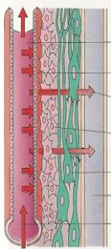
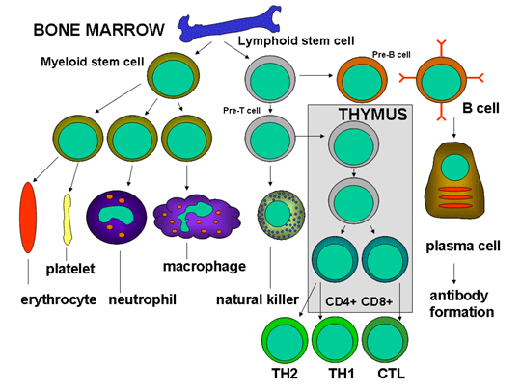
RECEPTOL® Mode of Action
RECEPTOL® Radha108 & PRP Nano-info peptides get absorbed in the blood through buccal mucosa and crosses the Blood Brain Barrier (BBB)
Acts via
Radha108 (PRP) promotes differentiation of B cells, differentiation & maturation of macrophages and monocytes.
Activates natural killer (NK) cells, cytotoxic cells of the innate immune system.
Mitigates cell fusion and docks on HIV glycoprotein like Gp120, 180,160 and 41 mimicking receptor on the cell surface closing entry of viruses that can be true for coronavirus Spike (S) protein aswell .
Stimulates production of cytokines
:IL-1 to IL-11, TNF-α, INF–γ.
Stimulates the maturation of immature thymocytes into either helper or suppressor T cells
Radha108 also functions as a molecular signalling device which works through receptors on target cell surfaces

Slide 7
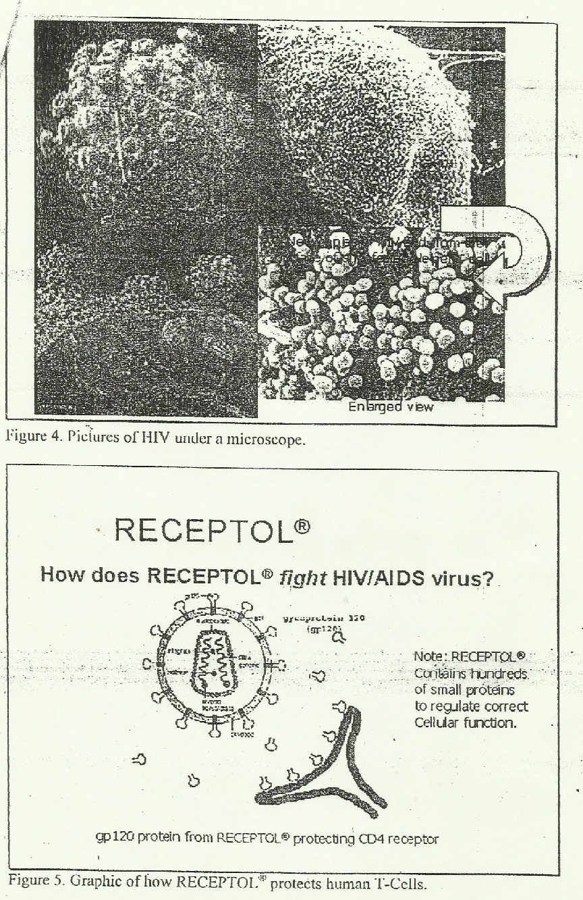
Common Mode of Action
Electron Micrograph Showing both HIV & Coronavirus unable to infect cells via Radha108 Naono-peptides Competitive inhibition on Cell surface with viral lock down
Receptol® Mode of Action in HIV/ AIDS
Receptol® Mode of Action in Coronavirus Scenario
Spike Glycoprotein (S)
Radha 108 Toll like Receptor® nanopeptides can block the attachment of S protein of Coronavirus as depicted above
Radha 108 Toll
like Receptor

Slide 8
Product USP
Common Mode of Action for All Viral Infection
Common Immunity Booster Vaccine Potential for all communicable viral infectious like AIDS, Swine Flu, Coronavirus, Allergy etc.
Prevent and treats all viral infection
As per study on HIV & Swine Flue.
1
5
Activates natural killer (NK) cells, cytotoxic cells of innate immune system Stimulating production of cytokines:IL-1 to IL-11, TNF-α, INF–γ.
Stimulates the maturation of immature thymocytes into helper or suppressor T cells to build strong immune system
2
6
Shield body against common infections like cough, cold, fever & diarrhoea,.
As per study on healthy subjects .
Increase strength & endurance, accelerate healing of injuries in athletes as IMMUNITY BOOSTER.
3
7
4
8
Radha108 also functions as a molecular signalling device which works through receptors on target cell surfaces preventing viral antigens entry into cellular system.
Helps in relief from allergies, asthma,
Immunity disorders, as per global study

Slide 9
Global Safety & Efficacy Studies on AIDS Patients
Safety and Efficacy achieved by global trials:
Phase I : 12 cohort 30 days (completely safe) in Ohio, USA
Phase II : 30 cohort 90 days (highly effective with no side effects)in Nairobi – Kenya
Phase III : 60 cohort for 365 days (highly effective with no side effects) in Rwanda, Africa
Phase III Indian Safety & Efficacy Mono Therapy Clinical Trials- with Radha 108 Nano Peptide by Government of India, Ministry of Health/National AIDS Control and Monitored by Indian Council of Medical Research/NARI* by US PATH accredited org.
Study I : 50 HIV Positive Patients at Tertiary Care LTMG Hospital Sion, Mumbai
(Clinical trial registry No. : CTRI-2012-08-002931)
Study II : 51 HIV Positive Patients at Tertiary Care LTMG Hospital, Sion, Mumbai
(ICMR Clinical Trial registry No. : CTRI-2012-09-002959)

Slide 10
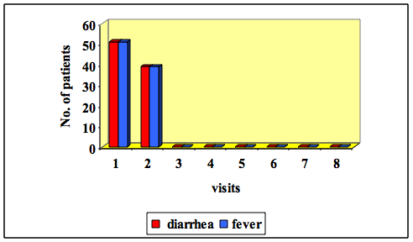
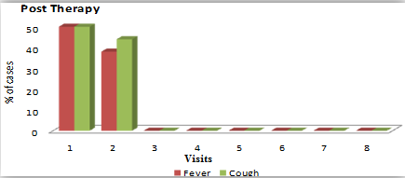
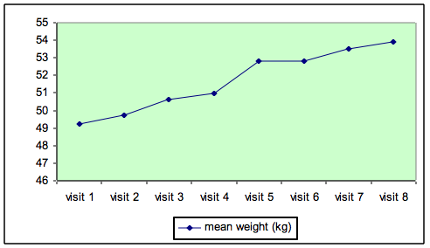
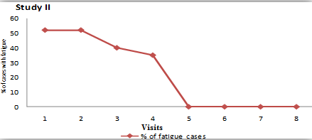
Indian Study : Stand Alone Study on AIDS Patients
Statistically significant reduction in Diarrhoea
Statistically significant reduction in Fever & Cough
Statistically significant gain in weight p<0.05
Statistically significant reduction in Fatigue / Malaise

Slide 11
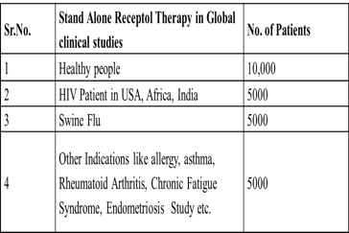
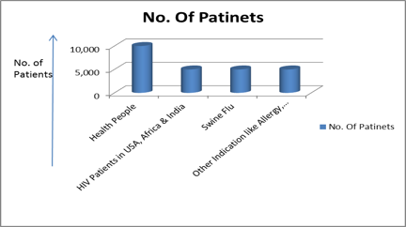
Meta Analysis on 25000 Subjects
Including healthy population
Objective: Ascertain the safety and efficacy of RECEPTOL ®
Sample Size: 25,000 Subjects
Scope: HIV, Swine Flu, Allergy/Asthma, Rheumatoid Arthritis , Endometriosis & NCD, Chronic Fatigue Syndrome
Hypothesis: Weight gain is an indication of wellness and overall health. No side effects with improved QoL showcases the safety and efficacy of the product.
Conclusion :
Study reveals that RECEPTOL ® oral spray therapy provides significant efficacy & safety in all groups of patients suffering from communicable & Immunity diseases with increased Quality of Life with increased weight gain in chronic patients. The product is completely safe with no side effects per 10 years follow up.
Stand Alone Radha 108 Therapy in
Global Clinical Studies

Slide 12
RECEPTOL ® Efficacy & safety Global Studies on Healthy Population
CHANGES IN MEAN BODY WEIGHT AMONG STUDY CASES
Duration (Weeks) | Mean weight ( ± SD) (N = 10000)
Baseline | 50.30 ± 10.02
1 | 50.65 ± 10.01
2 | 51.01 ± 09.96
3 | 51.47 ± 09.94
4 | 52.00 ± 09.96
Mean Diff. (Baseline – Wk1) (P value) | *00.35 ± 00.66 (0.001)
Mean Diff. (Baseline – Wk2) (P value) | *00.71 ± 01.24 (0.001)
Mean Diff. (Baseline – Wk3) (P value) | *01.17 ± 01.95 (0.001)
Mean Diff. (Baseline – Wk4) (P value) | *01.70 ± 02.15 (0.001)
After 1 week of treatment with Radha 108 Nano Peptide, mean weight showed a significant rise of 0.7% from baseline.
After 2 week of treatment with Radha 108 Nano Peptide, mean weight showed a significant rise of 1.4% from baseline.
Same trend was observed till the end of 4 weeks
By ANOVA P<0.05, * Significant

Slide 13
Efficacy & safety in Swine flu
CHANGES IN MEAN WEIGHT AMONG STUDY CASES
Duration (Weeks) | Mean weight ( ± SD) (N = 5000)
1 | 51.07 ± 9.82
2 | *51.51 ± 9.79
3 | *52.11 ± 9.75
4 | *52.53 ± 9.76
At the end of 2nd week, mean weight showed significant change from baseline i.e. mean change of 1.44 kg.
At the end of 4th week mean weight increased significantly that is 1.46 kg from baseline.
By ANOVA P < 0.05, * Significant

Slide 14
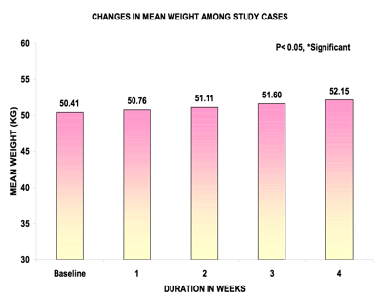
RECEPTOL ® Efficacy & safety of other indications like Allergy, Asthma, Arthritis, Diarrhoea, Fever, Fatigue-malaise, Anemia, Endometriosis
CHANGES IN MEAN WEIGHT AMONG STUDY CASES
Duration (Weeks) | Mean weight ( ± SD) (N = 5000)
Baseline | 50.41 ± 10.03
1 | 50.76 ± 10.01
2 | 51.11 ± 09.94
3 | 51.60 ± 09.91
4 | 52.15 ± 09.91
Mean Diff. (Baseline – Wk1) (P value) | *00.35 ± 00.57 (0.001)
Mean Diff. (Baseline – Wk2) (P value) | *00.70 ± 01.05 (0.001)
Mean Diff. (Baseline – Wk3) (P value) | *01.19 ± 01.77 (0.001)
Mean Diff. (Baseline – Wk4) (P value) | *01.74 ± 01.95 (0.001)
After 1 week of treatment, mean weight showed a significant rise of 0.7% from baseline.
After 2 week of treatment, mean weight showed a significant rise of 1.4% from baseline, similar trend was observed till the end of 4 weeks.
By ANOVA P<0.05, * Significant

Slide 15
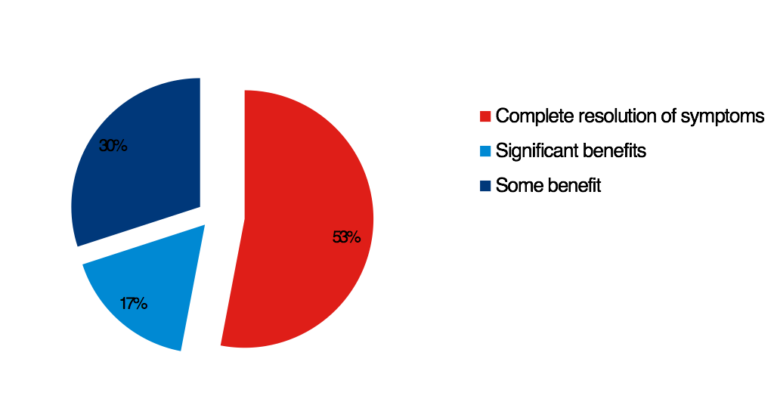
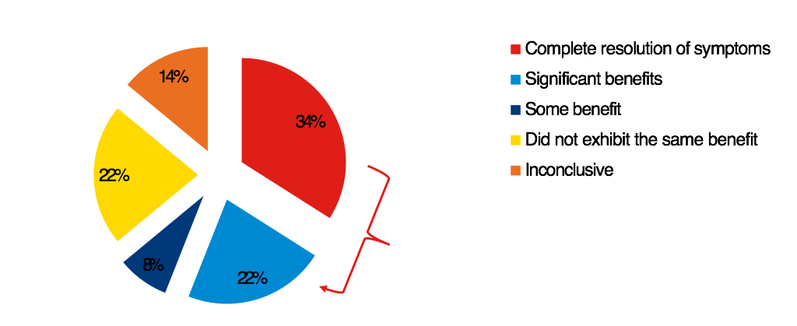
Global Studies on RECEPTOL ® Immunity Disorders
Allergies
Rheumetoid Arthritis
Reporting Patients : 24
Duration of Treatment : 6 months
Reporting Patients : 63
Duration of Treatment : 6 months
More than half the respondents experienced complete resolution of symptoms!
56% of patients found the product to be highly effective!

Slide 16
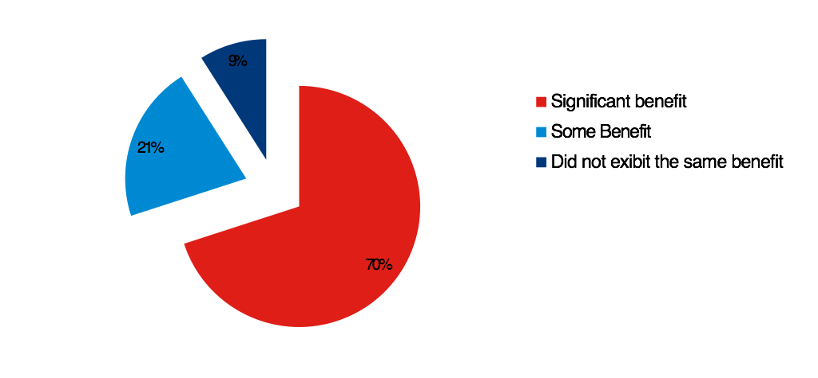
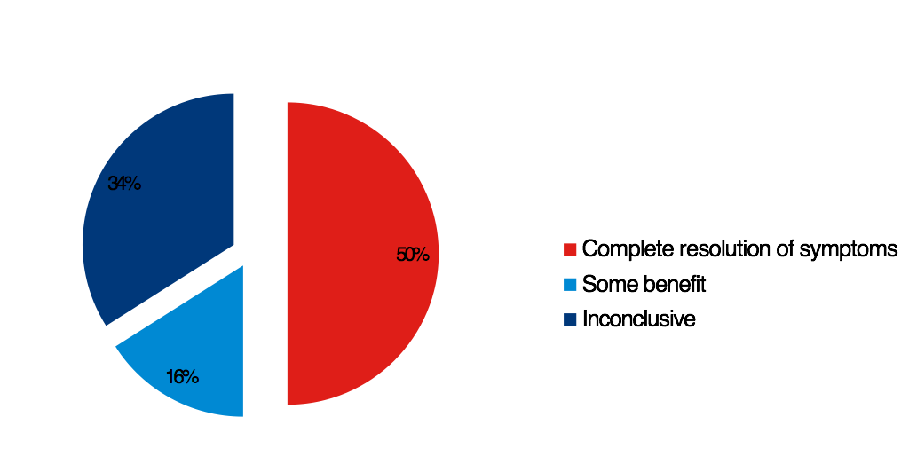
Global Studies on RECEPTOL ® Immunity Disorders
Chronic Fatigue Syndrome
Endometriosis
Reporting Patients : 108
Duration of Treatment : 6 months
Reporting Patients : 106
Duration of Treatment : 6 months
Similarly for Endometriosis, complete resolution in most cases!
70% of patients received significant benefits!

Slide 17
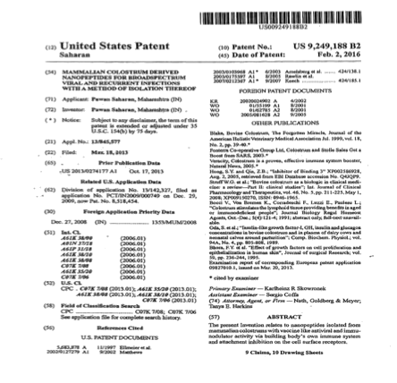
United States Patent
Patent No :-USA,249,188B2
Date of Patent :-Feb,02,2016
“ RECEPTOL ® ’s unique Mode of Action led to US & EU Govt granting product patents for 58 indications: starting from the common cold, influenza, allergies, asthma, Rheumatoid Arthritis, Swine Flu, Endometriosis, Chronic Fatigue Syndrome, etc. to life threatening HIV, and Cancer with US Product Patent # 9,249,188 along with Canadian, European, Indian, South African & Singapore patents. RECEPTOL® has also been approved by
Government of India for National Health Program.”

Slide 18
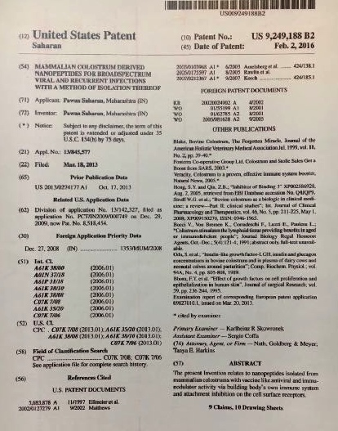
GLOBAL & US PATENTS FOR TREATMENT AND PREVENTION
OF ALL VIRAL & IMMUNITY DISEASE
The current invention related to mammalian colostrum provides answers to current and pipeline vaccine conjugates for preventing the majority of viral as well as bacterial communicable infections.
Abstract from US Patent 2016

Slide 19
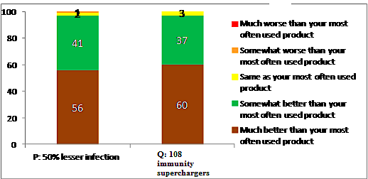
Receptol® Global Market Research
As Immunity Booster
IPSOS, USA & IRMA, India studied Doctors & Customer’s perceptions towards two concepts of the RECEPTOL® immune powder:
infection reducer for communicable viral infections.
immunity super charger along with their willingness to buy RECEPTOL® as stand alone & as an additive for prevention of Communicable and Immunity disorders.
Results were as follows:
RECEPTOL® met the mandate from 800 consumers in India, UK & United States in IPSOS, USA Study & 100 doctors and 120 consumers in IRMA, India study as stand-alone/additive as clinically proven immunity booster to prevent illness.
The ITP index was around 97-100%.
RECEPTOL® was added in liquid or powder form thereby differentiating and positioning them as immunity enhancing and health oriented products widening consumer base to include the rapidly growing segment of the world’s population who value health and wellness by consuming life-enhancing products.
80% of the respondents surveyed liked both the product concepts to prevent illness from viral infections.

Slide 20
S
U
M
M
A
R
Y
Innovation Journey - RECEPTOL® manufactured by Biomix was discovered by Dr. Pawan Saharan,MS,Ph.D. WVU, Stanford with eminent group of scientists including 2 times Nobel laureate Prof. George Wald from Harvard & Prof. Joseph Weizenbaum, MIT Founder Directors with 18 years of research and development with funding by the Department of Science & Technology, GoI.
Product - RECEPTOL®, made from Colostrum Nano-peptides helps people lead longer & healthier lives by building the body’s immune system, thus aiding in prevention and cure for all communicable & Immunity diseases: Coronavirus, AIDS, Swine Flu, RA, Allergy etc.
Active Ingredients (API) - Patented Nano - Informational Peptides ( Class 4 Proline Rich Poly Peptides & Radha108).
Mode of Action - Receptol® gets absorbed in the blood through the buccal mucosa and crosses the Blood-Brain-Barrier. It stimulates maturation of immature thymocytes into either helper or suppressor T cells. It stimulates secretion of Tumour Necrosis Factor & cytokines IL-1 to IL-11, INF-a, INF-y. Activates Natural Killer (NK) Cells, cytotoxic cells of the innate immune system by 5 times.
Indications -Treatment of HIV & for associated recurrent infections. Immunity enhancer for prevention of Communicable disease like Coronavirus n-CoV, Swine Flu, Influenza, Chronic Fatigue Syndrome.
USP- Innovative with common Mode of Action for all viral infections, affordable, globally patented, broad spectrum anti viral, immuno-modulator, easy to administer, 100% natural with side effects, can be consumed by all and has no age or sex barriers.
Global Patents - US Product Patent # 9,249,188, Canadian, European, Indian, South African & Singapore for 58 diseases.
GSK IPSOS Market Research: Glaxo Consumer Healthcare conducted Global Consumer Research via IPSOS on 800 families from India, UK & USA. The study concluded that 80% of the respondents surveyed were ready to pay a higher price for RECEPTOL®
Global Clinical Studies - Global Safety & Efficacy studies on AIDS & other indications : Highly efficacious and free of all side effects.
Goal - Helping billion lives via safe, affordable and effective treatment & prevention of All communicable disease.

Slide 21
TEAM
Founder CEO
Dr. Pawan Saharan, MS, PhD ( JNU, WVU )
AMP (ASCI in tie up with Harvard business school )
Best US graduate student scientist award by AAAS with fellowship at Stanford Medical Center, Palo Alto, CA.
Email id: biomix108@gmail.com / drpawan@biomix.in
Research Director
Dr. C. R. Bhatia, Ph.D., Post Doc. (BNL, NY, US),
DBT Secretary Govt. of India & Director: BARC,
Advisor: IAEC, Vienna
Project Director
Amitabh Thakore, B. Tech., MBA (IIM- Ahmadabad )
Research Advisor
Jean Zhang, Senior GSK R&D Scientist at Boston, USA
Pharma Drug Discovery & Therapeutic Solution since 2007
Founder Directors include
Late Prof George Wald, Harvard Medical Center
2 times Nobel Prize Winner
Prof Joseph Weizenbaum
Founder Chair Robotics Comp science Dept. MIT
Business Advisor
Ranjit Shahani BE IIT, MBA Jamnalal Bajaj
Chairman Novartis South Asia
Medical Directors
Dr. S.H. Advani, MD, FICP, FNAMS
Oncologist & President - Asian Cancer Society
Padamvibhusan awardee by President of India
Dr. Sushil Indoria , MD
Medical Director Life care Hospital, Thane
Dr. Sandhya Saharan, MD, DGO, Gynecologist and IVF
specialist.
Dr. Ali Irani - President API, Ortho & Sports
Medicine
Former Physiotherapist of Indian Cricket Team (12 years)
Email Id: dralirani@gmail.com
Business Development Executive
Hemangi Saharan, Bachelor of Management Studies
HR College of Commerce & Economics

