Slide 1
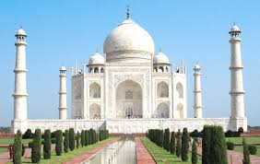
Indian Solution to Global Health Problems
via Technological Innovations &
Globally Patented Radha 108
The next Indian wonder
Dr. Pawan Saharan
www.biomix.in

Slide 2
1. Background overview
Contents
2. GMP facility & product range
3. Market potential as per global market research
4. Business proposition for next wonder drug
5. Global clinical data with meta analysis
6. Road ahead : Cash cow from Day 1
7. Team

Slide 3
1. Background overview

Slide 4
Journey of Radha 108 - “Dairy waste to life saving ”
Dr. George Wald, Nobel laureate & Prof. Joseph Weizenbaum, father of artificial intelligence at MIT, USA brain stormed with the Biomix team.
Poor Immunity was found to be the #1 reason for majority of diseases.
Several immunity drugs existed, however none could ; “build body’s own immunity like mother’s first milk”. This was the insight & lead for the research team.
After 10 years of research , we have successfully isolated Nanopeptides from bovine colostrum at our plant , located in world’s leading Amul dairy in Khatraj, Gujarat
Produced a natural product in form of an oral spray to be administered into buccal mucosa.
Creating paradigm shift in health care from ‘ Prevention to Cure’

Slide 5
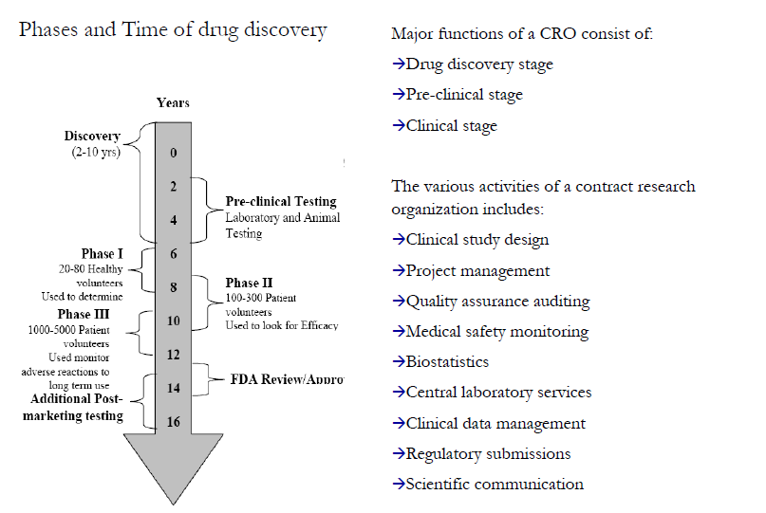
Phases & value of discovery - Radha108
$150Mn. in addition to govt. funding & sweat equity is $500Mn.

Slide 6
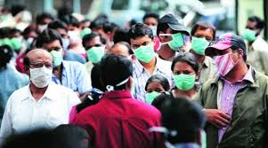
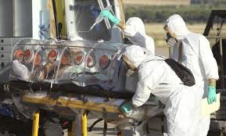

Global Health Challenges – Millions suffer from
Allergy & Asthma
Zika , Ebola, Swine Flu
HIV, TB, RA
Source : Lancet & TOI studies

Slide 7
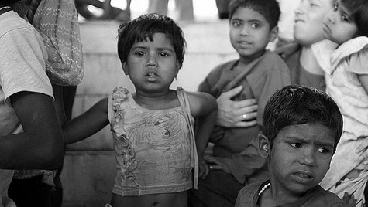
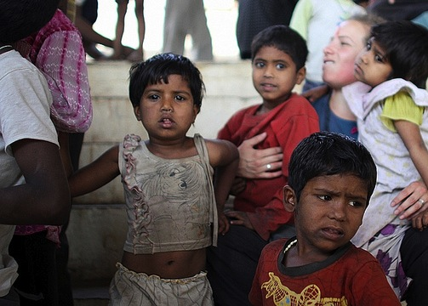
MILLIONS
MORE
SWINE FLU HIV/AIDS COMMON COLD HEPATITIS A, B & C HERPES SIMPLEX I&II ACUTE & CHRONIC VIRAL INFECTIONS VIRAL RESPIRATORY INFECTIONS DENGUE FEVER HUMAN PAPILLOMA VIRUS PHARANGITIS (VIRAL) SARS RABIES ROTA VIRAL DIARRHEA ALLERGIES & ASTHMA TUBERCULOSIS ALZHEIMER BENIGN PROSTATE HYPERPLASIA HEPATIC CELLULAR CARCINOMA HYPERTENSION LUPUS (DISCOID AND SYSTEMIC) ORAL THRUSH AUTISM PREMENSTRUAL SYNDROME AND ENDOMETRIOSIS RHEUMATOID & OSTEO ARTHRITIS SPINAL MUSCULAR ATROPHY
SUFFER FROM IMMUNE SYSTEM RELATED ILLNESSES

Slide 8

What if there was a way to treat most viral & all immunity disorders

Slide 9
Globally Patented : Radha108 drug
AFFORDABLE
EASY TO ADMINISTER
WITH NO SIDE EFFECTS
Can be consumed by all.. has no age or sex barrier, drug , drug interaction

Slide 10
What is Radha 108
Radha 108 Active Pharmaceutical Ingredients (API)
    API in Radha 108 consist of Nano – Informational Peptides extracted from mammalian colostrum via Ultra Nano filtration Technology having sequence id 1-8 ( provided on next slide) & Proline Rich Poly Peptides (PRPs)
    PRPs & Radha-108 are a class of nano informational peptide consisting of oligo-ribonucleotide attached to a peptide molecule that act as broad spectrum immuno-modulator & antiviral.
    Dosage - 3ml QDS via oral buccal spray (1 ml contains 0.03 grams of API Nanopeptides )
The ‘Biggest’ thing in Industry, just may be the ‘Smallest’ thing – Radha 108 Nanopeptides

Slide 11
Radha 108 API containing SEQ ID1- 8 (With globally granted patent )

Slide 12
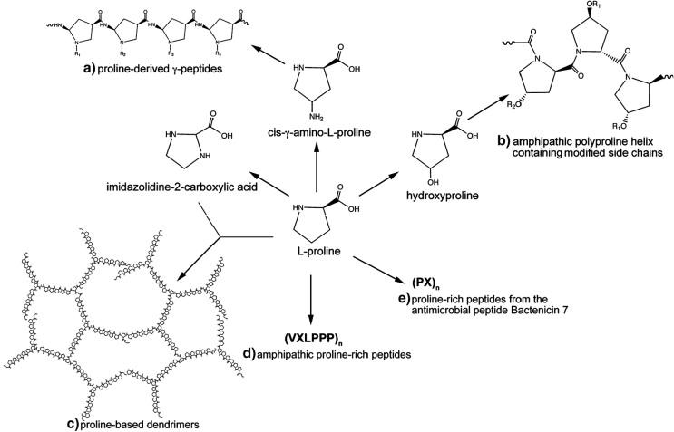
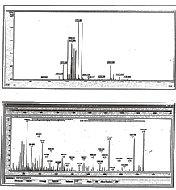
Chemical structure of API
Proline Rich Polypeptides
HPLC chart
Chemical Structure
Mass Spectrum

Slide 13
Mode of action - Pharmacodynamics
Radha108 series get absorbed in the blood through buccal mucosa and crosses BBB .
Stimulates the maturation of immature thymocytes into either helper or suppressor T cells
Radha108 (PRP) promotes differentiation of B cells, differentiation and maturation of macrophages and monocytes.
Activates natural killer (NK) cells, cytotoxic cells of the innate immune system
Stimulates production of cytokines IL-1 to IL-11, TNF-α, INF–γ.
Mitigates cell fusion and docks on HIV glycoprotein like Gp120, 180, 160 and 41 mimicking receptor on the cell surface closing spectrum entry of viruses.
Radha108 also functions as a molecular signaling device which works through receptors on target cell surfaces

Slide 14
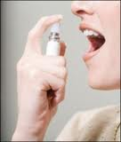
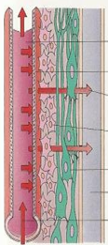
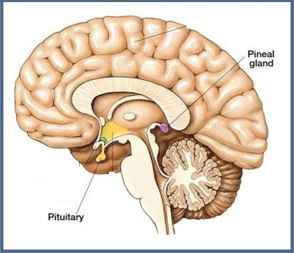
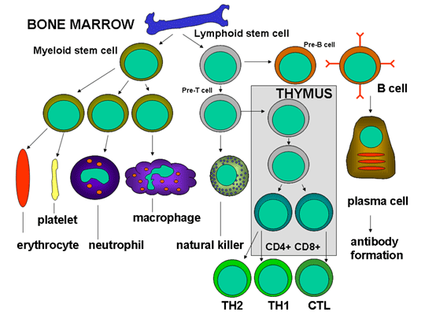
Mode of action - Science behind Radha108 efficacy
PRPs get absorbed in the blood through buccal mucosa and crosses BBB
Radha108 (PRP) promotes
differentiation of B cells,
differentiation and maturation
of macrophages and monocytes.
Activates natural killer (NK) cells,
cytotoxic cells of the innate
immune system
Mitigates cell fusion and docks on
HIV glycoprotein like Gp120, 180,
160 and 41 mimicking receptor
on the cell surface closing entry
of viruses.
Stimulates production of cytokines
IL-1 to IL-11, TNF-α, INF–γ.
Stimulates the maturation of
immature thymocytes into either
helper or suppressor T cells
Radha108 also functions as a
molecular signaling device which
works through receptors on target
cell surfaces

Slide 15
Mode of action
Pharmacokinetics
Radha 108 present in the formulation are readily absorbed through the buccal mucosa into the blood stream to directly reach the immune system. As the molecular weight of the molecules is below 2kdal it can cross any biological barrier including the blood brain barrier. They are readily metabolized and excreted.
Indications
The Radha 108 is indicated for all immunity disorders including HIV and recurrent infections as approved by US PTO for 58 indications given in the book on www.biomix.in
Contraindications
No adverse effect reported globally for the past 10 years, during global, clinical and operational studies including Acute & Sub- Acute Toxicology Animal study conducted by Indian council of medical research at National institute of nutrition, Hyderabad

Slide 16
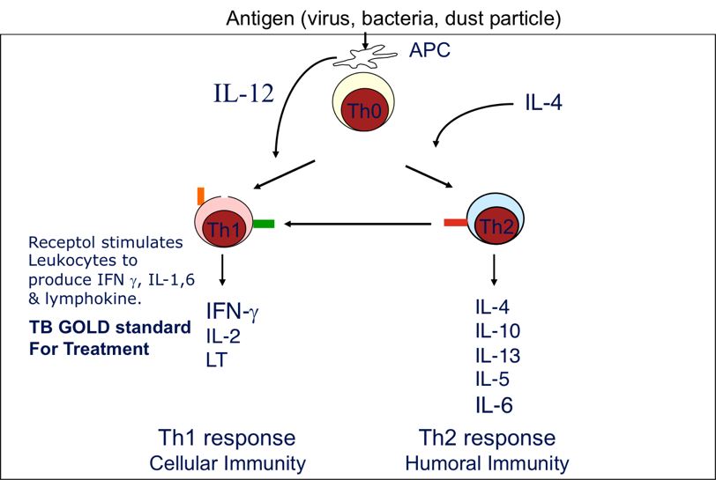
Mode of action
Mode of Action T Helper Cell Differentiation
via Radha108 Nano Peptide®

Slide 17
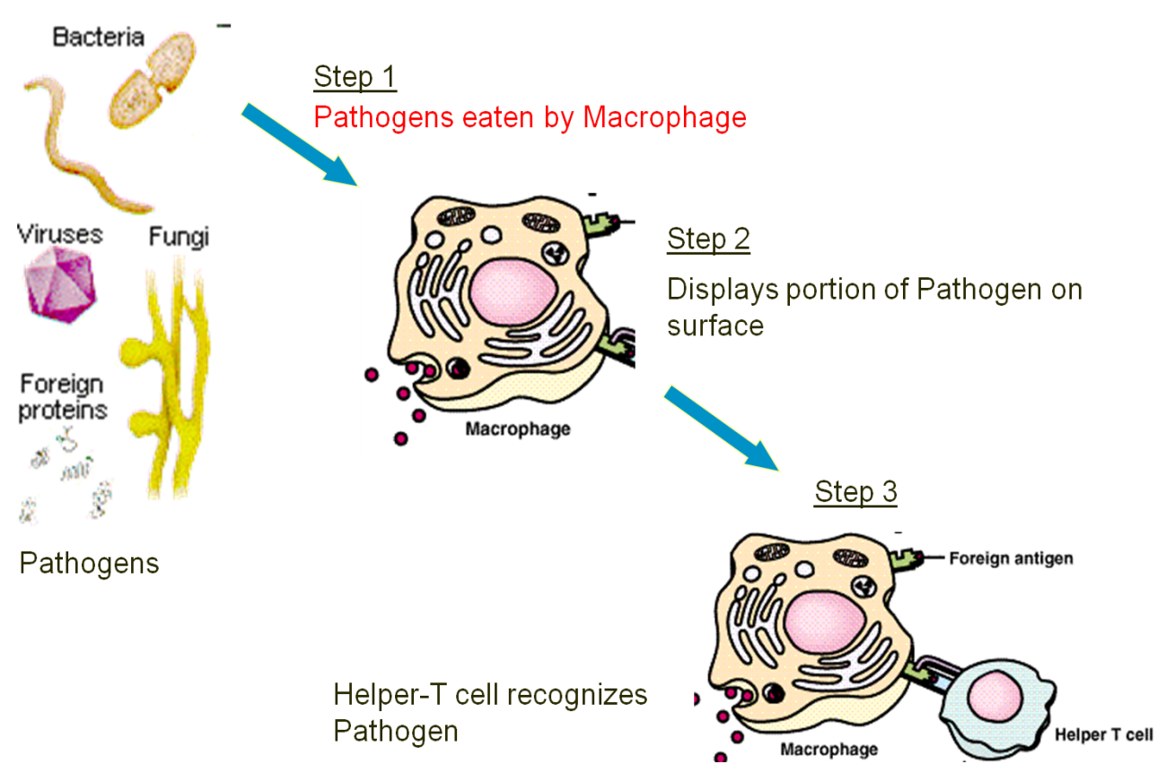
Mode of action
Radha108 Nano Peptide plays role in differentiation and maturation of macrophages and monocytes

Slide 18
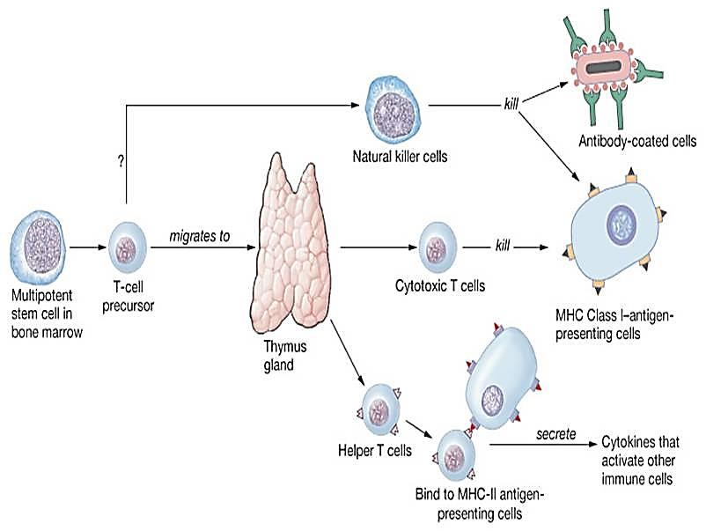
Mode of action
The activity of Natural Killer cells, cytotoxic cells of the innate immune system, was increased up to 5 times by Nanopeptides of Radha108 Nano Peptide

Slide 19
Mode of action
Radha 108 ( ) Immune response summary
Antigen
Macrophage
Helper T - Cell
Active Cytotoxic T-Cell
Kills Infected Cells
Memory T- Cell
Active B - Cell
Plasma Cell
Antibodies
Deactivates Antigens
Memory B-Cell
Displays copy of antigen
Cellular Immunity
Antibody Immunity

Slide 20
2. GMP Facility & Product range

Slide 21
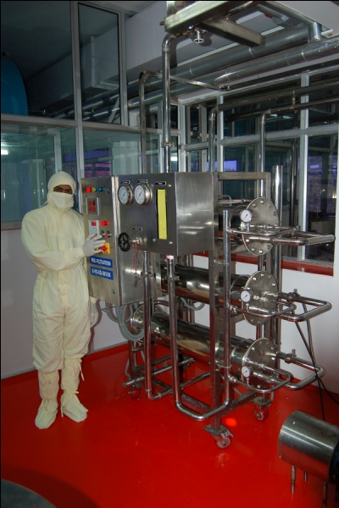
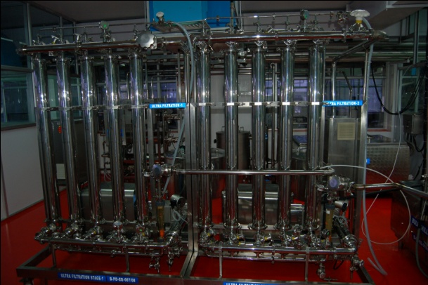
GMP - World class facility
Radha108 Nano Peptide manufacturing plant is state of the art, nano biotech facility approved by TUV Nord Germany since 2012. GSK Consumer healthcare group UK & India due diligence done on product & the manufacturing facility
  Consistent raw material source : International quality from ISO/GMP certified, Amul, world’s largest 75 year old dairy with stringent QC/QA checks & balances, right at the origin of Colostrum.
  Extraction of API, PRP (Radha108, Type of PRPs of molecular weight from 1800 to 500kDA ) is done by Merck Millipore Molecular Exclusion Ultra filtration columns of 100 to 10 kDA at cGMP facility shown below.

Slide 22
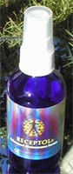
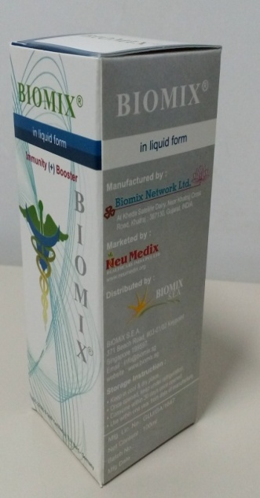
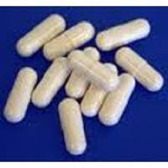
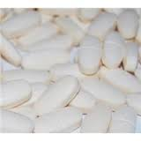
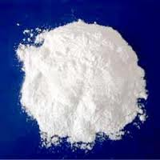
Radha 108 – Product range
Oral spray
Oral liquid
Capsules & Tablets
  Powder

Slide 23
Medical confirmation for granted 58 indications
(US Patent # 9,249,188)
Allergies , Asthma, HIV, Autoimmune Disorders,
Viral Respiratory Infection, Rheumatoid Arthritis, Endometriosis , Cancer, Lupus , Severe Acute Respiratory Syndrome (SARS), Cold & Flu
Benign Prostatic Hyperplasia ,
Premenstrual syndrome,
& Alzheimer’s, Hypertension,
Thrush,Austism, Perthes disease,, Prion disease, Psoriasis,
Sjogren’s syndrome, Spinal Muscular Atrophy,
Thrombocytopenia, Burns, Infection, Insect bites,
Daiper rash, Herpetic lesions, Pharangitis, Porphyria,
Raynaud’s phenomenon, Acute Viral Infection,
Dengue fever, Shingles,
, Plantar Warts,
Lymphoma , Herpes Simplex I & II, Parvo,
Sarcoidosis, Celiac disease, Chronic Pancytopenia,
Crohn’s disease, Diabetes type II,
Fibromyalgia Rheumatica, Mononucleosis,
Multiple Sclerosis,,
Osteo Arthritis, Brown Recluse Spider Bite,
Corneal Regeneration, Diarrhea,
Guillain Barre Syndrome, Hemolytic Anemia,
Idiopathic thrombocytopenia purpura,
Myasthenia Gravis, Tuberculosis,
Human Immunodeficiency Virus(HIV),
Hepatitis A and C, Rabies in Dogs,
Human Pappilloma Virus

Slide 24
Entry barrier via product patents
Jurisdiction | Application No./ Date | Title | Status
USA | 13/142,327 DT. 27.06.2011 | Mammalian Colostrum Derived Nanopeptides For Broad spectrum Viral And Recurrent Infections With A Method Of Isolation Thereof | GRANTED (PATENT# US8518454)
USA | U.S. Patent Application No. 13/845,577 | Mammalian Colostrum Derived Nanopeptides For Broad spectrum Viral And Recurrent Infections With A Method Of Isolation Thereof ( For approved 58 indications for Radha 108 ) | GRANTED ( Patent No. 9,249,188 )
SOUTH AFRICA | 2011/4687 DT. 24.06.2011 | Mammalian Colostrum Derived Nanopeptides For Broadspectrum Viral And Recurrent Infections With A Method Of Isolation Thereof | GRANTED ( PATENT # 2011/04687)
SINGAPORE | 201104717.2 DT. 29.12.2009 | Mammalian Colostrum Derived Nanopeptides For Broadspectrum Viral And Recurrent Infections With A Method Of Isolation Thereof | GRANTED (PATENT # 172793)
INDIA | 1353/MUM/08 DT. 27/06/2008 | Mammalian Colostrum Derived Nanopeptides For Broadspectrum Viral And Recurrent Infections With A Method Of Isolation Thereof | Approved
EUROPE | EP 09827010.1 DT. 30.06.2011 | Mammalian Colostrum Derived Nanopeptides For Broadspectrum Viral And Recurrent Infections With A Method Of Isolation Thereof | Approved
CANADA | 2478449 DT. 29.12.2009 | Mammalian Colostrum Derived Nanopeptides For Broadspectrum Viral And Recurrent Infections With A Method Of Isolation Thereof | Approved
PCT | PCT/IN09/749 DT. 29.12.2009 | Mammalian Colostrum Derived Nanopeptides For Broadspectrum Viral And Recurrent Infections With A Method Of Isolation Thereof | Entered into National Phase-South Africa, Europe, USA, Canada & Singapore
Hospital on chip | PCT/IN2011/000522 09.08.2011 | An Automated Integrated System, Method and Plate form For Healthcare Services | Granted(PATENT #:WO2012/020429)
Lab on chip | PCT/IN2010/000424 DT. 18.06.2010 | An Apparatus and Method For Detecting Biological State in Sample by Using Bio Marker ERS | Granted (PARENT #:WO2011/158246A1)

Slide 25
3. Market potential as per global market research

Slide 26
1 out of 3 Americans can be treated with Radha 108 : $10+ billion drug globally
*US alone accounts for
$5 Billion
*Estimated Unit sale 250MM
in US alone
Rest of the world can account for additional $8 billion market
* Radha 108 dosage of 4 times/day @ 3ml/ dose - 3 bottles/month/patient @$40 = $1440 / patient per year
Source: www.cdc.gov

Slide 27
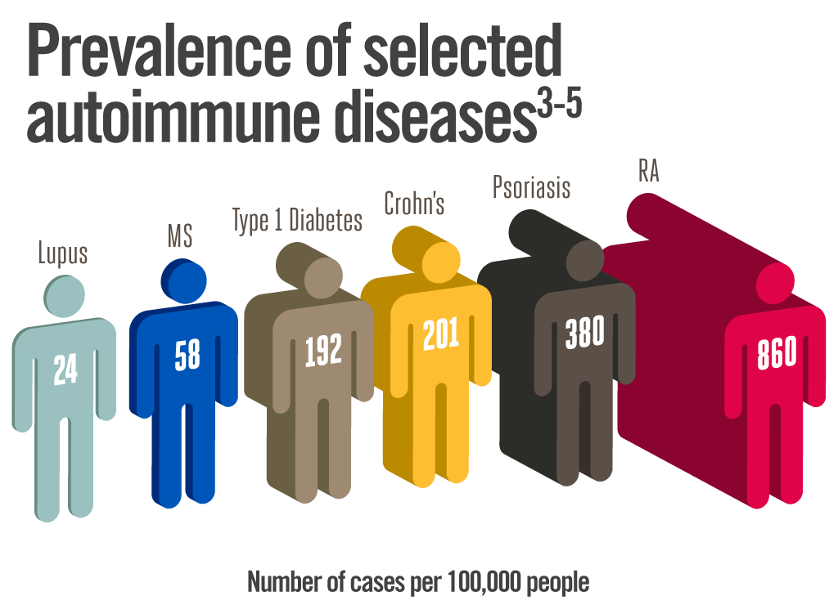
Auto immune disorders
In US alone, more than 23M people are affected by autoimmune diseases!
More than $100Billion is spent by sufferers on drugs every year!

Slide 28
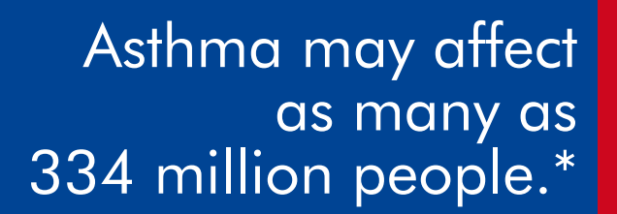
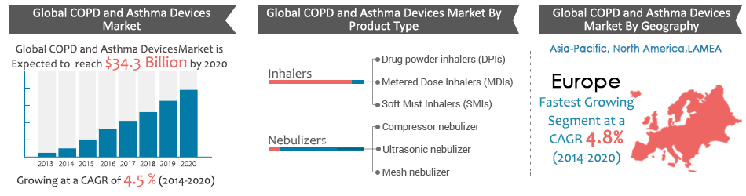
Asthma
EXPECTED TO GROW BY MORE THAN 100MM BY 2025!
25MM alone in US
*Source: www.GlobalaAthmaReport.gov

Slide 29


Allergies & Asthma
30% adults and 40% of children worldwide are affected by allergies!
Adults
Children
$
$25Billion is spent on Asthma drugs annually which has gone up by 50% since 2009!
*Source: www.GlobalaAthmaReport.gov

Slide 30
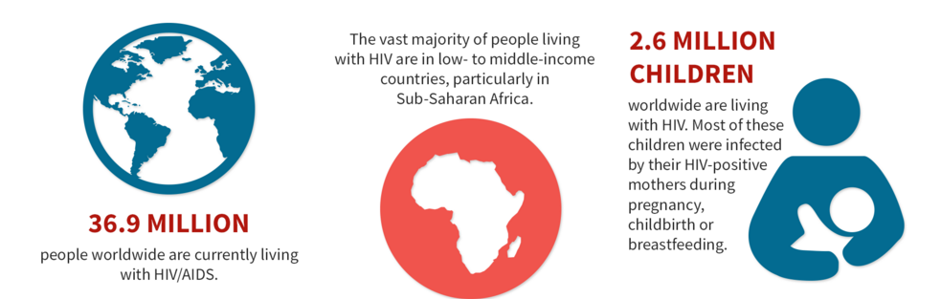
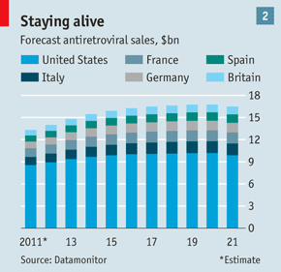
HIV is a major threat affecting ~40m people worldwide and the sales for HIV drugs are expected to increase steadily
1.2M only in US
Source: www.aids.gov
Forecast of HIV drug sales ($Billion)

Slide 31
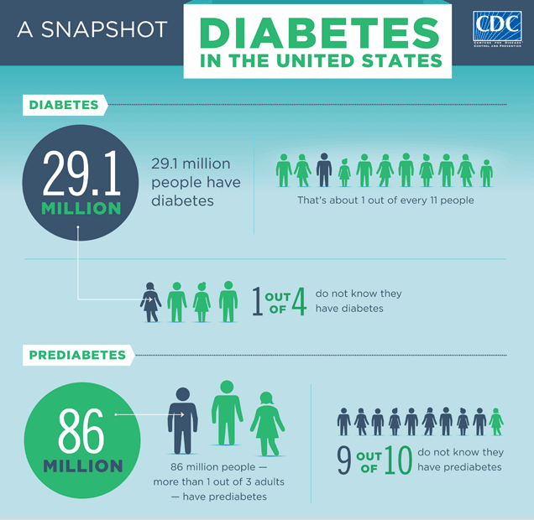
Diabetes
246M worldwide are affected by Diabetes!
$
$55Billion is spent on annually which has gone up by 55% since 2012!
*Source: www.cdc.gov

Slide 32
Market Research
1. *IRMA - Scope of the study : Doctor ’s perception for buying Radha 108, price and
distributing channel.
2. IPSOS by GSK consumer healthcare
Scope of the study : Customer’s perceptions towards two concepts of the immune powder and their willingness of buying HFDs (Health Food Drinks), and FMCG products with Radha 108 as an additive.
* Institute of rural management Anand, Gujarat

Slide 33
IRMA Study : Doctors opinion
Expected usage Pattern
3 Cities - AHD – Ahmadabad, MUM – Mumbai, NDL – New Delhi

Slide 34
IPSOS GSK study
Research conducted in Mumbai, Chennai, Ludhiana and Patna. Study consists the data of 800 respondents.
Target population: Households of SEC A in society consuming HFDs and FMCG products.
Product: Radha 108 powder in two concepts.

Slide 35
Concept P (50 % lesser infection)
Concept P (50% lesser infection) – A trusted nourishment and dependable immune power of cow colostrum.
Reduces common infections like those of stomach, nose and throat by up to 50% lesser infection using Radha 108 powder.
ITP index 100 and ITP score 40%.
- ITP index (Concept Performance vs Success Norm)
- ITP score (Maximum trial potential in % within target)

Slide 36
Concept Q (108 Immunity superchargers)
2. Concept Q (108 immunity superchargers) : Packed with 108 immunity superchargers.
Builds protection against all Pathogen types- Viruses, bacteria and fungi.
ITP index 97 and ITP score 39%.

Slide 37
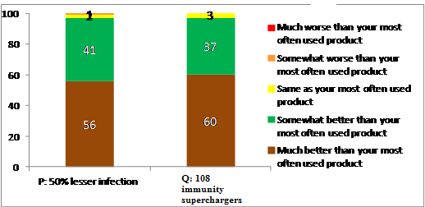
Product perception & Intended purchase pattern
Respondents told that both the formulations of the product are much better than their existing products in use.

Slide 38
4. Business proposition for next wonder drug

Slide 39
Business proposition
Radha108 can be sold in select markets to be a cash cow from Day 1
Radha108 efficacy & safety is clinically tested in global market
Product registration in regulatory markets for multiple indications based on granted global patents with the help of clinical research from the partner MNC.
Radha108 can be used as first line or adjunct therapy for different indications based on solid clinical data
Global marketing & distribution network along with innovative patented technology makes Radha108 choice of 21st century blockbuster drug.
The uniqueness of Receptol is in Radha 108 8 sequences of amino acid monomers responsible for providing mode of action in a vaccine like manner with active immunity that led to US and European Patent and license authorities to grant exclusivity for 58 indications including Cancer, Auto immune disease like RA etc., Allergy & Asthma, infectious disease like AIDS and hepatitis etc. for 21 years. Such attributes are missing in all other colostrum forms available world over.

Slide 40
Strategic fit for MNC
Make it globally available using existing marketing & distribution network
Launch Radha 108 in India (with $100Mn. GoI and other export orders) & select global territory
Doing further clinical studies at Stanford medical centre & other institutes in United states & Europe for various indications that have been patented, based on mode of action & select clinical studies conducted on HIV, asthma, allergies, RA, endometriosis & other chronic ailments such as cancer & diabetes .
Fleming discovered Penicillin G, which saved millions from bacterial infections. Radha 108 will save billions from viral infections & immune disorders

Slide 41
Regulatory approvals
India : License number - GA/1647
US : Orphan drug status for colostrum by USFDA, coupled by granted patent make Radha108 a unique selling proposition for all immunity disorders as per the granted US patents in USA ( US 9,249,188 B2 & US8518454)
Singapore, South Africa , Kenya, Australia & select European territory : Nutraceutical approval with collection of clinical data to file IND application for select indication

Slide 42
Proposed commercial, R&D relationship
Licensing, marketing & distribution in select global territories via product licensing based on product patents
Setting up of world class manufacturing facilities in EU & US. Based on proprietary , patented technology offered by Biomix with appropriate upfront, milestone & royalty payment.
National AIDS Control Organization (NACO), GoI in collaboration with WHO is already using in it first line therapy for select patients population > 500 CD4 count
For certain indications like Recurrent Infection due to common cold & Immunity disorders including HIV, Global clinical data is available
Clinical trial on Rheumatoid Arthritis (63 patients), Allergy (24 patients), Endometriosis (108 patients) & Meta analysis of 25,000 subjects for these & HIV, swine flu & healthy population can be used to conduct further studies in US & Europe.

Slide 43
  Rx Prospect
Radha108 has a better prospect in ethical prescription market based on safety & efficacy study conducted for Global Study.
Asthma, Allergy, HIV, Auto immune disorder, diabetes, cancer & other viral respiratory infections as per the granted US patents in USA ( US 9,249,188 B2), Singapore ( #172793), South Africa(#2011104687), European (App. No. 09827010.1), Canada (App. No.: 2,748,449)
Thus Radha108 is a unique prescription drug mimicking some of the natural products that became blockbuster prescription drugs viz.. BMS (Taxol) & AZ (Nexium).

Slide 44
5. Global clinical data with meta analysis

Slide 45
Radha 108 Nano Peptide Safety, Efficacy & Acceptability
On Immuno compromised HIV subjects used as the model
Preclinical Safety: as per NIN National Toxicology Panel
No Acute Toxicity & No Sub Chronic Toxicity
Revalidation Phase III Indian Trials – Stand alone MONOTHERAPY with Radha 108 Nano Peptide sponsored by Government of India, MOH/NACO and Monitored by ICMR/NARI*
Study I (2006-07) : By GoI on 50 Patients at LTMG Hospital Sion, Mumbai (Clinical trial registry No. : CTRI-2012-08-002931)
Study II (2007-08) : By GoI on 51 Patients at LTMG Hospital, Sion, Mumbai (Clinical Trial registry No. : CTRI-2012-09-002959)
The study was fully controlled, conducted and sponsored , by Govt. of India, Biomix was facilitating the same & had no control on the specifications.
Safety and Efficacy Achieved by Global Trials:
Phase I : 12 cohort 30 days (completely safe) in Ohio, USA
Phase II : 30 cohort 90 days (highly effective with no side effects)in Nairobi – Kenya
Phase III : 60 cohort for 365 days (highly effective with no side effects) in Rwanda, Africa

Slide 46
Toxicology study at National institute of nutrition (NIN)
Pre-Clinical safety study has been undertaken as per schedule Y of DCGI guideline under the supervision of Dr. B. Dinesh Kumar, Asst. Director (Study director) at National Institute of Nutrition, Hyderabad.
Acute toxicity
  * Indian council of medical research ( ICMR )
1. | Animal selected | SPRAGUE DAWLEY RATS (of both the sexes)
2. | Weight of the animal | 150–180 gm (for both the studies)
3. | Age of the animal | 4 to 6 weeks (for both the studies)
4. | Route of Administration | Oral
RESULTS
No pre-terminal deaths after administration of 50 times of intended therapeutic dose through oral route
All rats were found to be active and with normal body weight.
No Acute toxicity found.

Slide 47
NIN Study : Sub acute data
No mortality was observed & product is safe
1. | No. of Rats used | 48
2. | Categories | Vehicle control (VC), Therapeutic dose (TD – 1.08ml), Average dose (AD – 5XTD), (five times of TD) and High Dose (HD – 10XTD), (ten times of TD)
3. | Days of trial | 45
4. | Period of Observation | Biweekly for live phase, cage side, physical and neurological parameters. At 48hrs and 15th day hematology and biochemistry profile along with gross necropsy and histopathology of major organs were evaluated.
RESULTS
No significant difference in physical activity and neurological activity between control and test groups throughout the study period.
No significant abnormalities in hematology , clinical chemistry profile in blood/serum samples.
No gross lesions were found in any organ and no significant difference in histopathology of various organs.
No sub chronic toxicity found

Slide 48
Global Trial Results
Phase I – Ohio State University, USA
12 cohort, 30 days, moderate dose
Patients may have previous exposure to AZT
Balanced diet with vitamin-minerals provided
10 patients had weight gain and 7 patients had gained an average 6 lbs
Highest weight gain was 12 lbs for a patient who was HIV positive for 10 years
All 12 pt had improved symptom assessment score and average reduction approached 63 %
Free of side effects

Slide 49
Phase II – Nigeria, Africa
Advanced HIV / AIDS, Limited access to conventional treatment
30 cohorts, 30 days Mono therapy
No previous exposure to ART
Some signs of detoxification, relieved by increase water intake
Resolution or reduction in all Clinical symptoms
Weight gain observed in all patients
Efficacious & Free of side effects

Slide 50
Phase III – Rawanda, Africa
Safety and efficacy trial
60 AIDS patients – 365 days
Patients were unaware of positive potential of drug
Weight gain consistently observed
After day 1 moderate level of relief of diarrhea and fever
After 14 days, relief from skin lesion, mouth thrush, fever, diarrhea, tuberculosis symptoms
After 90 days relief of all symptoms with increase in Absolute CD4 Counts & Reduction in Viral Load
No adverse effects observed over 12 months follow up with improved Quality of Life even after 5 years of therapy.
Highly Efficacious & Free of side effects

Slide 51
India mono-therapy snapshot
Stand alone Mono-therapy Safety and Efficacy in HIV+ AIDS Patients:
Study I – Sion Hospital, Mumbai on 50 HIV+ Patients
  Absolute CD4 cell count & HIV Viral Load – tested at NABL accredited Metropolis lab,
  Mumbai
  Clinical & Physical symptoms study - at ART Center, OPD Center, Sion Hospital, Mumbai
  Inclusion criteria – absolute CD4 cell count greater than 100 cells/mm³
  Exclusion criteria – no pre- exposure to ART
  Mean HIV log viral load has statistically significantly dropped (p < 0.001)
  Statistically significant increase in CD4 cell count (p = 0.06)
  Clinical symptoms disappeared in 3 weeks of treatment in All Patients (p<0.05)
  Statistically significant weekly weight gain in All Patients (p<0.001).

Slide 52
Summary of study 1 data (Mumbai, India phase III )
Visit (Weeks) | No. of Subjects with Nausea | No. of Subjects with Vomiting | No. of Subjects with Fatigue/ Malaise | No. of Subjects with Diarrhea | No. of Subjects with Fever | No. of Subjects with Cough
1 | 8 | 7 | 44 | 9 | 12 | 14
2 | 3 | 2 | 32 | 5 | 3 | 10
3 | 2 | 2 | 26 | 1 | 6 | 6
4 | 1 | 1 | 17 | 1 | 1 | 3
6 | 0 | 1 | 1 | 0 | 0 | 1
8 | 0 | 0 | 1 | 0 | 0 | 2
10 | 0 | 0 | 1 | 0 | 0 | 0
12 | 0 | 0 | 0 | 0 | 0 | 0
Sr. No. | CD4 count N=48 | Before | After 12 Weeks | p-value
1. | Median | 312.5 | 363.5 | 0.06
2. | 25th Percentile | 275.5 | 294.2
3. | 75th Percentile | 430 | 435
Sr. No. | Parameter | Before | After 12 Weeks | p-value
1. | Log of HIV-1, RNA (N=34) | 5.11(0.090) | 4.103(1.32) | < 0.001
2. | Median | 206057 | 25280 | < 0.001
3. | 25th Percentile | 62884 | 1665
4. | 75th Percentile | 508038 | 87511

Slide 53
India mono-therapy snapshot
Study II – Sion Hospital, Mumbai on 51 AIDS Patients
  Absolute CD4 cell count & HIV Viral Load – tested at IIH (ICMR)
  Clinical & Physical symptoms study - at ART Center, Sion Hospital
  Inclusion criteria – absolute CD4 cell count greater than 100 cells/mm³ and 100%
  symptomatic patients at basal.
  Exclusion criteria – no pre- exposure to ART
  Mean HIV log viral load has statistically significantly dropped (p < 0.009)
  Statistically significant increase in CD4 cell count (p < 0.042)
  Clinical symptoms disappeared in 3 weeks of treatment in All Patients (p<0.001)
  Statistically significant weekly weight gain in All Patients (p<0.001).

Slide 54
Summary of study 2 data (Mumbai, India phase III )
Clinical Symptoms | N | At Baseline | Responders At Week-2
Diarrhea | 51 | 51(100%) | 12(23.53%)
Nausea | 51 | 51(100%) | 3(5.9%)
Vomiting | 51 | 51(100%) | 17(33.3%)
Fever | 51 | 51(100%) | 13(25.5%)
Cough | 51 | 51(100%) | 13(25.5%)
Paraesthesia | 51 | 51(100%) | 16(31.4%)
Disturbed Sleep | 51 | 51(100%) | 0(0%)
Skin Rash | 51 | 51(100%) | 7(13.7%)
Fatigue/Malaise | 51 | 51(100%) | 51(100%)
Herpes Zoster | 51 | 51(100%) | 18(35.3%)
Hair Changes | 51 | 51(100%) | 16(31.4%)
Leukoplakia | 51 | 51(100%) | 5(9.8%)
Oral Thrush | 51 | 51(100%) | 51(100%)
Parameter | Baseline Mean ± SD | Week 12 Mean ± SD | Difference ( Week 12- Baseline) Mean ± SD | P-value
CD4 Counts (cells/ cmm) | 317.16 ± 128.67 | 344.24 ± 165.79 | + 27.08 ± 92.47 | 0.042
CD8 Counts (cells / cmm) | 1037.06 ± 285.02 | 1139.75 ± 386.76 | +102.69 ± 267.44 | 0.008

Slide 55
Indian Study : STAND ALONE MONOTHERAPY
SION HOSPITAL MUMBAI
Weight gain after treatment
Statistically significant gain in weight p<0.05 in both the Study I and Study II
Study 1
Study 2
Study I : average weight gain of 4.73 kg after 12 weeks of Radha 108 therapy. statistically significant (p < 0.05)
Mean weight was 50.48 kg at start of study.
Study II : average weight gain of 4.68 ± 1.9 kg after 12 weeks of Radha108 therapy. statistically significant (p < 0.05)
Mean weight was 49.21kg at start of study and 53.89 kg after 12 wks.

Slide 56
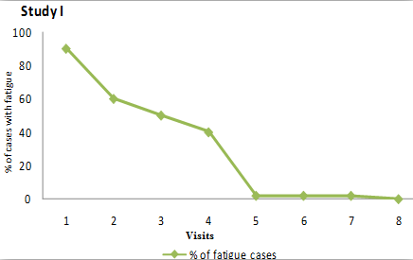
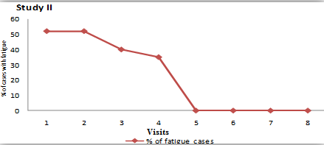
Data on chronic fatigue syndrome after therapy
Statistically significant reduction in Fatigue / Malaise in both the Study I and Study II
Study 1
Study 2
Study I:
88 % of the total study cases had fatigue at basal.
After 6th week onwards only one or two patients had fatigue, statistically significant
Study II:
100 % of the total study cases had a symptom of fatigue at basal. At the end of 2nd week proportion of symptoms of fatigue had a statistically significant fall from basal.

Slide 57
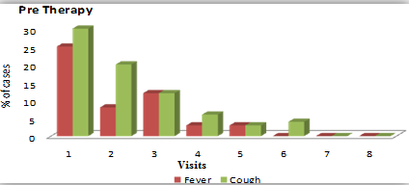
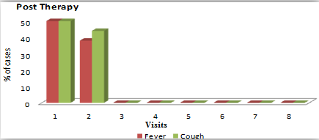
Data on fever & cough after Therapy
Statistically significant reduction in Fever and Cough in both the Study I and Study II
Study 1
Study 2
Study I: Fever and cough was reported by 24 % and 28% of total study cases at basal respectively. After treatment at the end of 4th week proportion of patients with symptom of fever and cough had a statistically significant fall
Study II: 100 % of the total study cases had fever and cough.
after treatment from 3rd week onwards all the patients had relief from fever and cough, statistically significant

Slide 58
Data on Diarrhea after Therapy
Statistically significant reduction in Diarrhea in both the Study I and Study II
Study 1
Study 2
Study I: 18 % of the total study cases had diarrhea at basal and after treatment from 5th week onwards all the patients had relief from diarrhea, statistically significant
Study II: 100 % of the total study cases had diarrhea at basal and after treatment from 3rd week onwards all the patients had relief from diarrhea, statistically significant

Slide 59
Reduction in HIV Viral load
Data on HIV viral load after Therapy
Statistically significant reduction in HIV Viral Load
Study 1
Study 2
 | Viral Load baseline | Viral Load 3 months
Mean | 335278.23 | 141053.42
Median | 92457.50 | 25332.50
 | Viral Load baseline | Viral Load 3 months
Mean | 119243.49 | 38814.33
Median | 38108.00 | 14073.00
Study I: The mean HIV log viral load has statistically significantly dropped from 4.63 to 4.18 after 12 weeks of treatment.
(p = 0.03)
Metropolis Health Services (I) PVT. LTD. Laboratory, Mumbai (NABL & CAP accredited)
Study II: The mean HIV log viral load has statistically significantly dropped from 4.41 to 4.02 after 12 weeks of treatment.
(p = 0.009)
Institute of Immuno Hematology (IIH), an ICMR Institute, KEM Hospital, Mumbai

Slide 60
Data on CD4 Cell Count after therapy
Statistically significant increase in CD4 Cell Count
Study 1
Study 2
 | CD4 baseline | CD4 3 months
Mean | 370.63 | 390.65
Median | 312.50 | 363.50
 | CD4 baseline | CD4 3 months
Mean | 317.16 | 344.24
Median | 276.00 | 305.00
Study I: There was increase in CD4 count on the average by 51 (median CD4 cell counts from 312 to 363). this is of statistical significance
(p = 0.06)
Study II: There was increase in CD4 count on the average by 27 (median CD4 cell counts from 276 to 305). This is of statistical significance
(p = 0.042)

Slide 61
Radha 108 in NCDs : Rheumetoid Arthritis Study
Reporting Patients* : 63
Duration of Treatment : 6 months
56% of patients found the product to be highly effective!

Slide 62
Radha 108 in NCDs : Fatigue Syndrome Study
Reporting Patients* : 108
Duration of Treatment : 6 months
70% of patients received significant benefits!

Slide 63
Radha 108 NCDs : Allergies Study
Reporting Patients* : 24
Duration of Treatment : 6 months
More than half the respondents experienced complete resolution of symptoms!

Slide 64
Radha 108 in NCDs : Endometriosis Study
Reporting Patients* : 106
Duration of Treatment : 6 months
Similarly for Endometriosis, complete resolution in most cases!

Slide 65
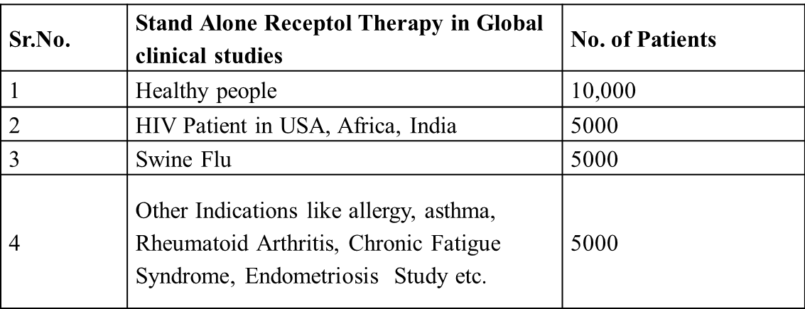
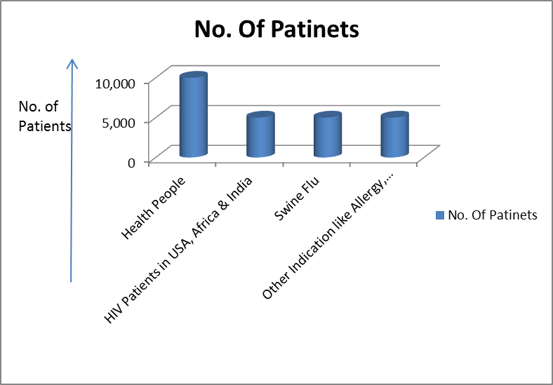
Meta Analysis
Meta Analysis is a combined Statistical analysis of 25,000 subjects across HIV, Swine Flu, Allergy/Asthma, Rheumatoid Arthritis , Endometriosis & NCD: Chronic Fatigue Syndrome showing increase in weight gain as an Indication of overall wellness showing Safety & Efficacy of Radha108 Nano Peptide.
Stand Alone Radha 108 Therapy in Global Clinical Studies

Slide 66
Efficacy & safety of on Healthy Population
CHANGES IN MEAN BODY WEIGHT AMONG STUDY CASES
Duration (Weeks) | Mean weight ( ± SD) (N = 10000)
Baseline | 50.30 ± 10.02
1 | 50.65 ± 10.01
2 | 51.01 ± 09.96
3 | 51.47 ± 09.94
4 | 52.00 ± 09.96
Mean Diff. (Baseline – Wk1) (P value) | *00.35 ± 00.66 (0.001)
Mean Diff. (Baseline – Wk2) (P value) | *00.71 ± 01.24 (0.001)
Mean Diff. (Baseline – Wk3) (P value) | *01.17 ± 01.95 (0.001)
Mean Diff. (Baseline – Wk4) (P value) | *01.70 ± 02.15 (0.001)
By ANOVA P<0.05, * Significant
After 1 week of treatment with Radha 108 Nano Peptide, mean weight showed a significant rise of 0.7% from baseline.
After 2 week of treatment with Radha 108 Nano Peptide, mean weight showed a significant rise of 1.4% from baseline.
Same trend was observed till the end of 4 weeks

Slide 67
Efficacy & safety of on HIV+ patients in USA, India
CHANGES IN MEAN WEIGHT AMONG STUDY CASES
Duration (Months) | Mean weight ( ± SD) (N = 5000)
Baseline | 50.38 ± 09.89
1 | 50.72 ± 09.88
2 | 51.07 ± 09.82
3 | 51.51 ± 09.79
4 | 52.11 ± 09.75
5 | 52.54 ± 09.76
6 | 52.89 ± 09.77
Mean Diff. (Baseline – 1 month) (P value) | *00.34 ± 00.57 (0.001)
Mean Diff. (Baseline – 2 months) (P value) | *00.69 ± 00.91 (0.001)
Mean Diff. (Baseline – 3 months) (P value) | *01.13 ± 01.39 (0.001)
Mean Diff. (Baseline – 4 months) (P value) | *01.73 ± 01.71 (0.001)
Mean Diff. (Baseline – 5 months) (P value) | *02.16 ± 01.76 (0.001)
Mean Diff. (Baseline – 6 months) (P value) | *02.51 ± 02.07 (0.001)
By ANOVA - Significant
After 1 month of treatment, mean weight showed a significant rise of 0.7% from baseline.
After 2 months of treatment, mean weight showed a significant rise of 1.4% from baseline, similar trend was observed till the end of 6 Months.

Slide 68
Efficacy & safety of on Swine flu
CHANGES IN MEAN WEIGHT AMONG STUDY CASES
Duration (Weeks) | Mean weight ( ± SD) (N = 5000)
1 | 51.07 ± 9.82
2 | *51.51 ± 9.79
3 | *52.11 ± 9.75
4 | *52.53 ± 9.76
By ANOVA P < 0.05, * Significant
At the end of 2nd week, mean weight showed significant change from baseline i.e. mean change of 1.44 kg.
At the end of 4th week mean weight increased significantly that is 1.46 kg from baseline.

Slide 69
Efficacy & safety of other indications like allergy, asthma, arthritis, diarrhea, fever, fatigue-malaise, anemia, endometriosis
Duration (Weeks) | Mean weight ( ± SD) (N = 5000)
Baseline | 50.41 ± 10.03
1 | 50.76 ± 10.01
2 | 51.11 ± 09.94
3 | 51.60 ± 09.91
4 | 52.15 ± 09.91
Mean Diff. (Baseline – Wk1) (P value) | *00.35 ± 00.57 (0.001)
Mean Diff. (Baseline – Wk2) (P value) | *00.70 ± 01.05 (0.001)
Mean Diff. (Baseline – Wk3) (P value) | *01.19 ± 01.77 (0.001)
Mean Diff. (Baseline – Wk4) (P value) | *01.74 ± 01.95 (0.001)
By ANOVA * Significant
After 1 week of treatment, mean weight showed a significant rise of 0.7% from baseline.
After 2 week of treatment, mean weight showed a significant rise of 1.4% from baseline, similar trend was observed till the end of 4 weeks.

Slide 70
Conclusion by Dr. Kailash Ghandewar, Biostatistician
This observation study reveals that after Radha108 Nano Peptide oral spray therapy, mean weight of study cases showed significant increase from baseline to end of treatment and these changes were observed in both the genders.
Hence these results indicate that Radha108 Nano Peptide oral spray is very effective and safe among cases with indications like HIV, Swine flu, Allergy, Asthma, Arthritis, Diarrhea, Fever, Fatigue-Malaise, Anemia, Endometriosis etc. showing increase in weight gain as a parameter for overall wellness and improved quality of life, even in healthy population.

Slide 71
6. Road ahead : Cash cow from Day 1

Slide 72
Next steps
Launch Radha 108 in India (with 100M $ GoI and other export orders) & select global territory
immediately based on regulatory approvals using global network of marketing &
distribution with entry barrier based on global product patents received for Radha 108.
Doing further clinical studies in US & EU for URTI, Recurrent infections & HIV and help close
research study at Stanford Medical Center, Palo Alto, CA., USA.
Using leadership in URT infections & can make Radha 108 choice of 1st line therapy
for all viral & other recurrent infections..in addition to immunity disorders in USA & EU using orphan
drug status and granted two strong Product Patents.
Setting up of world class manufacturing facility in USA, Australia and Europe where we
received proposals from local Govt authorities and PMOs based on our proprietary , patented
technological innovations in collaboration with Make in India of GoI and EU Govts.

Slide 73
Granted Patents for Hospital & Lab on Chip
Hospital on Chip (2011288135) is the Universal Virtual Specialty Hospital providing all services & research as Mass General Hospital , Boston, Harvard Medical Center via Tele & emergency medicine, CRO, Drug discovery & diagnostics driven by proprietary AIKAT. (Artificial intelligence based Knowledge acquisition tools)
Lab on Chip is a device to detect virus, bacteria, Pollutants & Biological/Nuclear war fares impact on human & livestock. The invention relates to an apparatus and method for detecting biological state in a sample using biomarkers.

Slide 74
Team
Founder CEO
  Dr. Pawan Saharan, MS, PhD ( JNU, WVU )
    AMP (ASCI in tie up with Harvard business school )
    Best US graduate student award by AAAS with fellowship at Stanford University
    Email id: biomix108@gmail.com / drpawan@biomix.in
Research Director
  Dr. C. R. Bhatia, Ph.D., Post Doc. (BNL, NY, US),
    DBT Secretary Govt. of India & Director: BARC, Advisor: IAEC, Vienna
    Email id: bhatia@gmail.com
Project Director
  Amitabh Thakore, B. Tech., MBA (IIM- Ahmadabad )
    Email id: agthakore@yahoo.com
Ms. Priti Patel - B.Pharm, M.Pharm (R&D & QA )
    Email id: pritipatel@biomix.in
Medical Directors
  Dr. S.H. Advani, MD, FICP, FNAMS
  Oncologist & President - Asian Cancer Society
  Padamvibhusan awardee by President of India
  Email id: shadvani2000@yahoo.com
Dr. Sushil Indoria , MD
Medical Director Life care Hospital, Thane
Email id: Sushilindoria@yahoo.in
Dr. Sandhya Saharan, MD, DGO, Gynecologist and IVF
specialist. Email id: drsandhyasaharan@hotmail.com
Dr. Ali Irani - President API, Ortho & Sports Medicine Former Physiotherapist of Indian Cricket Team (12 years ) Email Id: dralirani@gmail.com
Eminent scientists, engineers, doctors from World over with over 300 years of collective experience

